Slide 1
Regional Transportation Plan
Coordinated Mobility and Accessibility Committee
November 19, 2025

Slide 2
Coordinated Planning Needs
Coordinated Planning informs decision making
  Needs for infrastructure for walk/bike/roll
  Needs for transit service and facilities
Highlight DRAFT RTP on the following topics:
  Active Transportation
  Transit needs
  Regional Transit Access Assessment

Slide 3
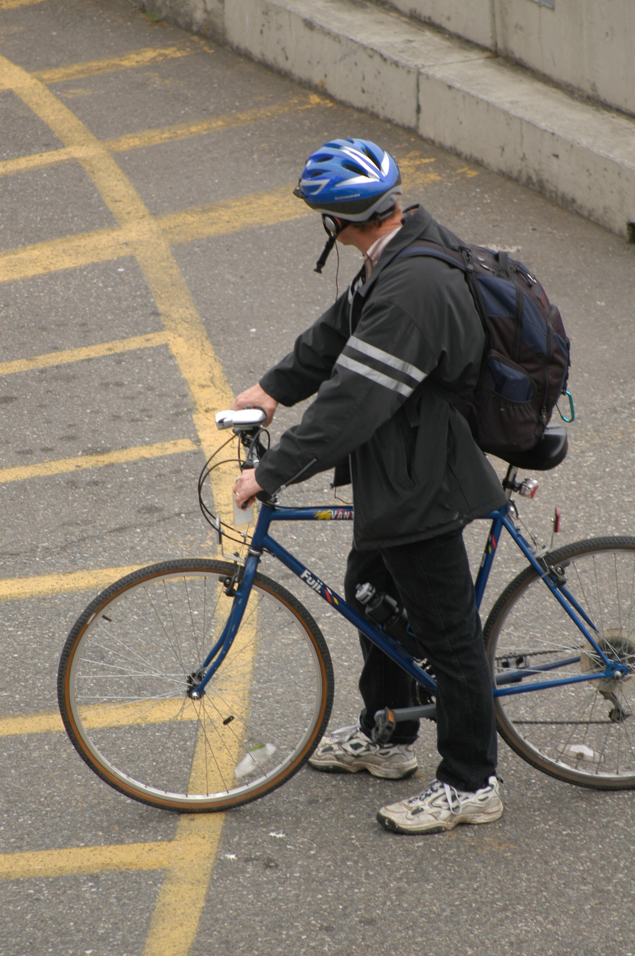
Active Transportation in the DRAFT RTP
New Content for the 2026 RTP
First update of our Pedestrian and Bicycle Facility Inventory
Bicycle Level of Traffic Stress Analysis
Incorporation of ped/bike High-Injury Network, Density information, and updated EFAs
Developed a methodology for identifying pedestrian and bicycle gaps on the regional network.

Slide 4
Active Transportation in the DRAFT RTP
Gap Analysis Categories
Map of Sidewalk Gaps in Lakewood
Category | Definition
1 | These segments are on the Pedestrian/Bicycle HIN, within a supportive density, in an equity focus area and have no or partial pedestrian and/or bicycle facilities.
2 | These segments are on the Pedestrian/Bicycle HIN, or within a supportive density, or in an equity focus area and have no or partial pedestrian and/or bicycle facilities.
3 | These segments have no or partial pedestrian and/or bicycle facilities.
4 | These segments have complete bicycle facilities but a level of traffic stress value of 3 or 4.

Slide 5
Transit in the DRAFT RTP
Transit Service & Transit-Supportive Densities
Density | Frequency & Span | Transit Service
At least 7 people + jobs per acre | Service with at least 2 trips per hour between 6am and 8pm | Local Transit
At least 15 people + jobs per acre | Service with at least 3 trips per hour between 5am and 10pm | All Day Service
At least 25 people + jobs per acre | Service with at least 4 trips per hour between 6am and 6pm | Frequent Service
At least 40 people + jobs per acre | BRT, Light Rail, Commuter Rail or Ferry at varying frequencies and spans | High-Capacity Transit

Slide 6
Transit in the DRAFT RTP
Transit Service Gaps Today vs. 2050
Transit Service | Current System | Future System (2050)
Local Transit | 33% | 15%
All Day Transit | 36% | 20%
Frequent Transit | 11% | 0%
High-Capacity Transit | 16% | 34%

Slide 7
Regional Transit Access Assessment in the DRAFT RTP
Developed methodology for assessing transit access needs across the region.
Applied to current system and 2050 system
Assess population and employment with the highest transit access needs in the following categories.
Address High Injury Network
Enhance Pedestrian Infrastructure
Expand Bike Network
Improve Route Directness
Manage Parking Demand

Slide 8
Interactive Transit Access Tool
January – May 2026:
PSRC and consultant team will develop an online map that allows users to visualize the transit access typologies for the region (current system and future system) using the selected census geography.
The tool will also:
direct users to the strategies recommended for each typology and
dynamically show the impact of specific local data, such as neighborhood greenway program, on transit access, using the methodology applied to regional transit access.

Slide 9
Schedule to Plan Adoption
November 20 – Virtual RTP Regional Public Meeting
December 11 – TPB authorizes staff to release the draft plan for public comment
  Public comment period open from mid-December to end of January 2026
  Additional outreach to focus groups, key stakeholders
January through April 2026 – board reviews public comments, finalizes plan document
May 2026 – General Assembly plan adoption

Slide 10
Thank You!
Gil Cerise
Program Manager
gcerise@psrc.org
Nick Johnson
Associate Planner
njohnson@psrc.org

