Slide 1


Breakout Group Slides
Passport to 2044: Equity Impact Assessment August 22, 2023
1

Slide 2
Agenda
Presentation – (10:05 – 10:55) Q&A - (10:55 – 11:05) Breakout discussions – (11:05 – 11:50) –- details below Reconvene and report out – (11:50 – 11:55) Wrap up – (11:55 – 12:00)
 | Guidance for Breakout Discussions
Things to note before breakout discussion | Zoom timer in the upper right-hand corner can be used to reference remaining time. Please email Maggie Moore (mmoore@psrc.org) if you get stuck. A PSRC staff person will join your group to assist.
11:10-11:45a | Breakout groups answer questions together. See instructions and resources available in this document to help fill in your responses. The person with the last name that starts closest to “A” will serve as the facilitator (unless another volunteer steps forward). Feel free to share your screen and notes with the group if that’s helpful for facilitation.
2

Slide 3
REIA Worksheet | Breakout Groups
Instructions – Imagine your group is developing a comprehensive plan for the region. Use slide #4 to answer the following question. Feel free to share examples not included in slide #4 that you prefer, or that you think would be most effective.
Question – What early inclusive community engagement work should be conducted?
Type here!

Slide 4
Inclusive Community Engagement Examples
Build Relationships
Remove Barriers
Advisory committees
Making meetings accessible (e.g., time of day, location, translation, etc.)
Compensating participants
Amenities (e.g., childcare)
Co-creation with community members
Various methods for input (account for social, economic, and cultural differences)
Click here for more examples

Slide 5
REIA Worksheet | Breakout Groups
Instructions – Imagine your group conducted community engagement using the strategies you described. Using slide #6 select one “key issue” you may have heard during that engagement and answer the question below.
Question – What key issue emerged from this community engagement?
Type here!

Slide 6
Community Engagement Feedback
Key Issues
Housing is too expensive. I can’t find a home that fits in my family’s budget.
There have been a lot of traffic collisions in my neighborhood. I don’t feel safe letting my kids walk home from school.
It’s been challenging to find a job. And even more challenging to find a job that pays me enough to afford to live here.

Slide 7
REIA Worksheet | Breakout Groups
Instructions – Select one of the regional policies from slides #8 - #10 that most appropriately addresses the hypothetical “key issue” your group selected.
Question – What policy from the comprehensive plan is being analyzed in the Racial Equity Impact Assessment?
Type here!

Slide 8
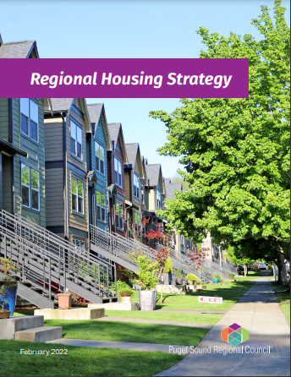
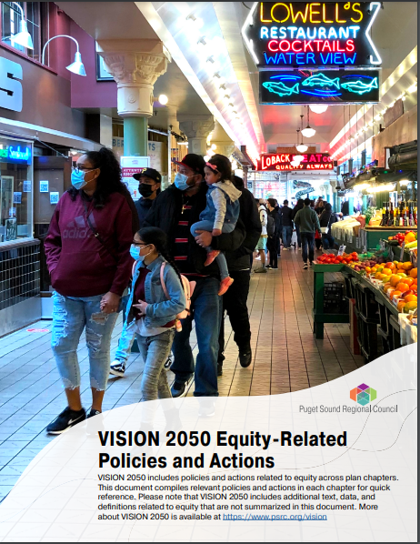
Equity and Housing
MPP-H-5: Promote homeownership opportunities for low-income, moderate-income, and middle-income families and individuals while recognizing historic inequities in access to homeownership opportunities for communities of color.
8

Slide 9
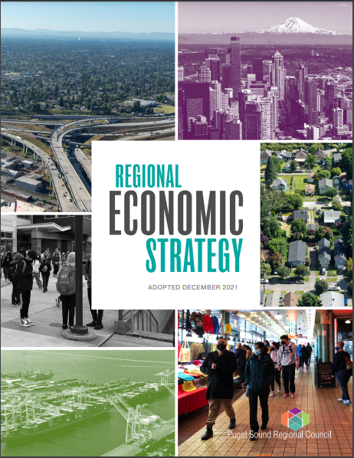
Equity and Economics
MPP-Ec-13: Promote equity and access to opportunity in economic development policies and programs. Expand employment opportunity to improve the region’s shared economic future.
9

Slide 10
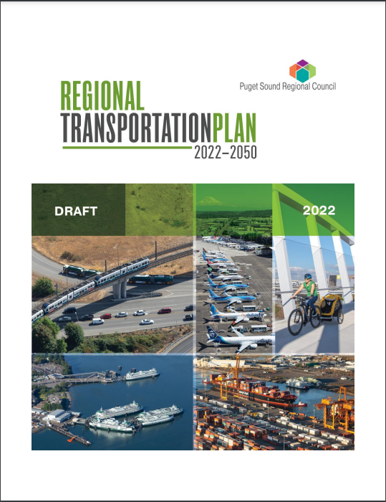
Equity and Transportation
MPP-T-4: Improve the safety of the transportation system and, in the long term, achieve the state’s goal of zero deaths and serious injuries.
10

Slide 11
REIA Worksheet | Breakout Groups
Instructions – Identify some key takeaways from slides #12 - #16 that are most relevant to the “key issue” and policy your group selected.
Question – What does data show you about racial inequities in the region?
Type here!

Slide 12
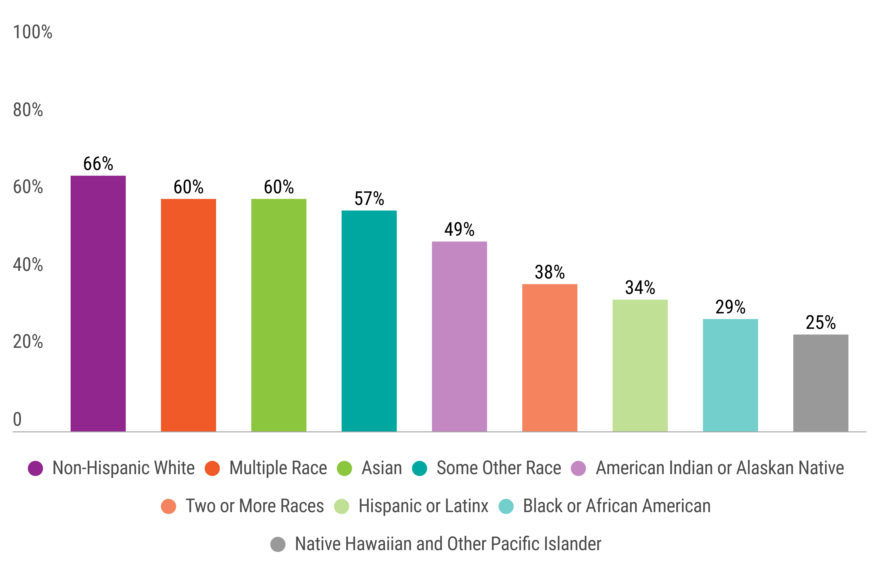
Regional Homeownership Rates by Race
12

Slide 13
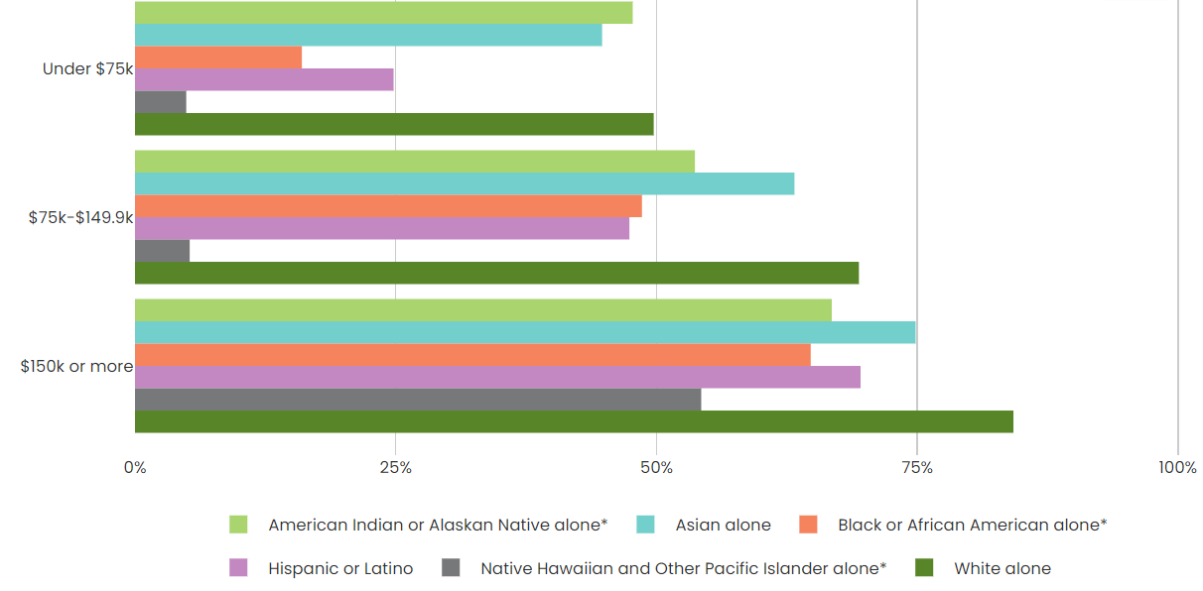
Regional Homeownership Rates by Income and Race
13

Slide 14
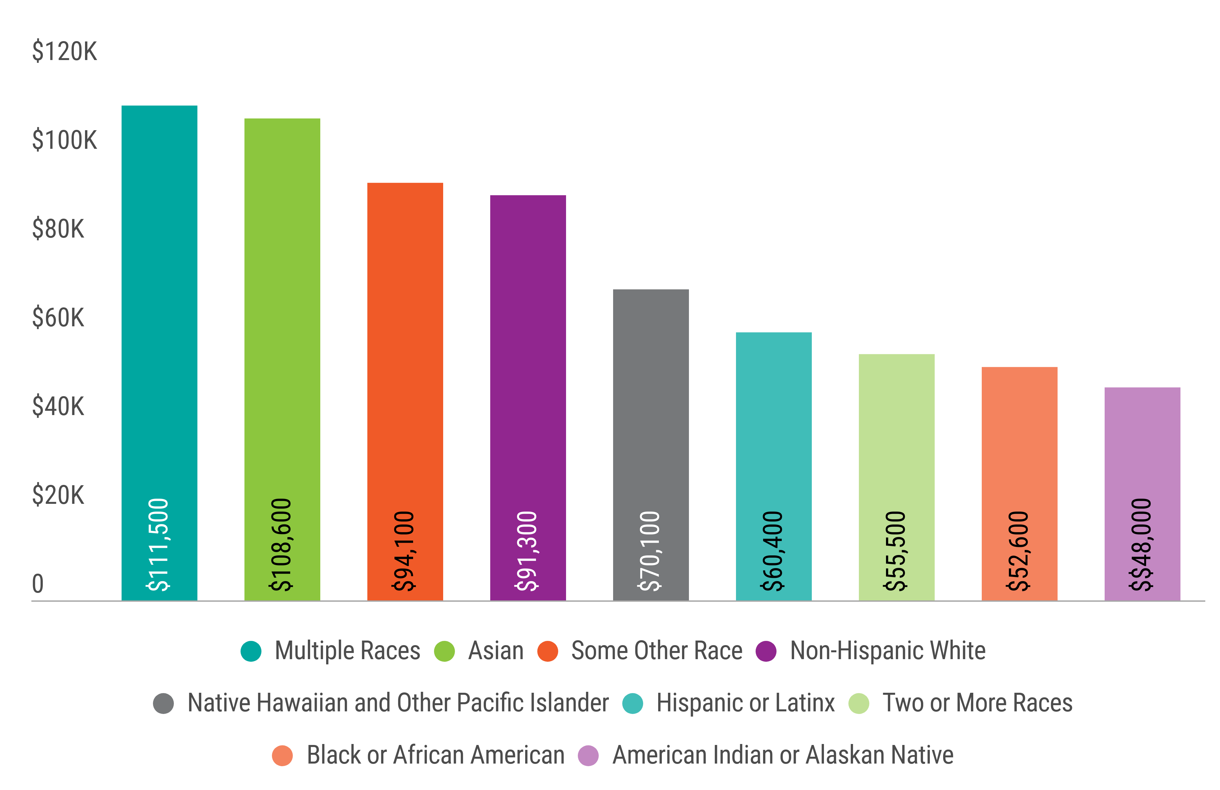
Regional Median Income by Race
14

Slide 15
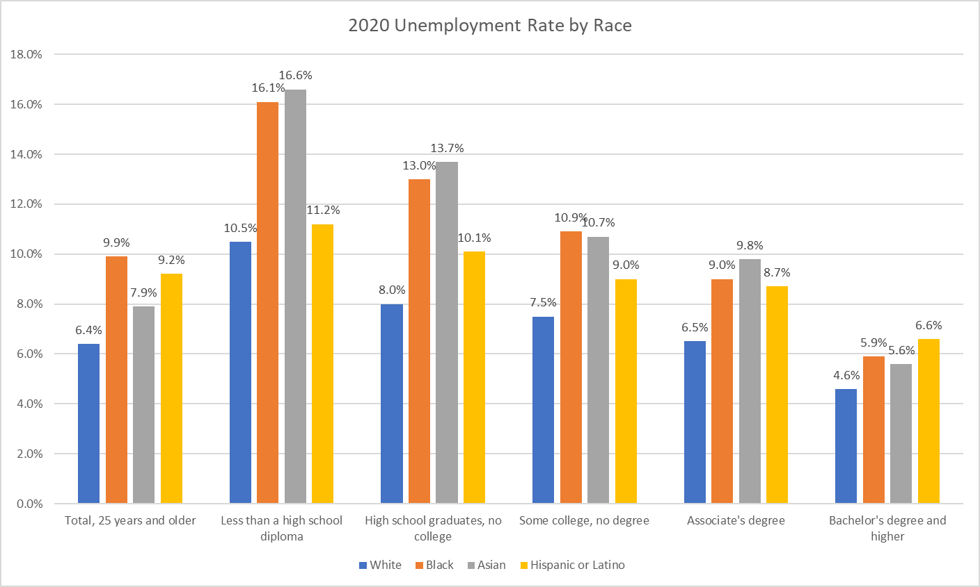
Regional Unemployment Rates by Race and Education
Source: U.S. Bureau of Labor and Statistics, Current Population Survey.
15

Slide 16
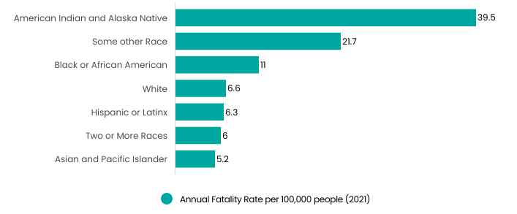
Regional Transportation Deaths by Race
Source: Washington Traffic Safety Commission, Washington State Coded Fatal Crash (CFC) analytical data files
16

Slide 17
REIA Worksheet | Breakout Groups
Instructions – Identify the strategies from slides #18 - #20 that your group thinks would effectively address these racial inequities. Feel free to share examples not included in slides #18 - #20.
Question – What are potential strategies for reducing the inequities identified for the comprehensive plan proposal and how will they be implemented?
Type here!
17

Slide 18
Housing Strategies
Inclusionary Zoning
Stipulates that new residential development in certain zones includes affordable housing units.
Density Bonuses
Permits more housing units, taller buildings, or more floor space in exchange for a public benefit, such as affordable units or contributions to a housing fund.
Alternative Homeownership Models
Provide long-term affordability and opportunities to build wealth via community land trusts, co-ops, lease purchase programs, etc.
Click here for more examples
18

Slide 19
Economic Strategies
Training and Certification
Expand training and certification opportunities to increase small, minority and women-owned business participation in government projects and procurement opportunities.
Eliminate Bias
Develop a Hiring Academy to provide cohorts of companies with a structured process and consulting services to help them institute evidence-based hiring processes that are designed to eliminate bias in hiring.
Community Workforce Agreements
Expand the use of community workforce agreements and priority hire programs to expand job access and job quality for underrepresented communities.
Click here for more examples (pgs. 31-32)
19

Slide 20
Transportation Strategies
Equitable Resource Distribution
Target services and facilities toward populations and geographies that are disproportionally affected by health and safety burdens, acknowledging that policies and designs that improve conditions for vulnerable groups can benefit everyone in the community.
Staff Diversity
Increase the diversity of agency staff at all levels of leadership and decision-making so that the workforce represents a range of backgrounds and life experiences and reflects the community it serves.
Discounted Services
Offer free or discounted bicycle safety training, helmets, repairs, etc. for those in need living in low-income communities where professional services are not available.
Click here for more examples
20

